Slide 1

You are all great….
In your shopping basket

Slide 2
xxxx
Objective
xxx
Key Risk
xxxwe go…
Any questions – please talk to any member of the Leadership Team or write comments/questions on the innovationandchange Slack Channel – we will respond!!

Slide 3
“I love Gusto but not enough to pay their prices”
“I’m fed up shopping and buying the ingredients that I have…”
“My food plan was developed in the 80’s…”
“Need help to stay healthy but I can’t afford it…”
“We’re all bored with what I cook…”

Slide 4
Lean Canvas

Slide 5
Key Themes
INSERT GRID WITH STICKIES 2X2

Slide 6
Competitor Analysis
WORDING

Slide 7
Competitor Analysis
Make up 2 X 2 USING LOGO

Slide 8
MVP AND EXPERIMENT

Slide 9
PERSONAS

Slide 10
Not the right format but has the content…
Objective
KPIs
Objective
Key Results
Metric
Confidence
x/10
Progress
%complete
How will we know when we’re done?
EXPERIMENT RESULTS

Slide 11
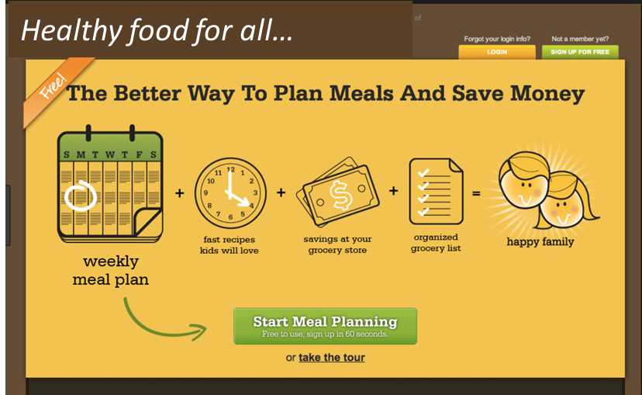
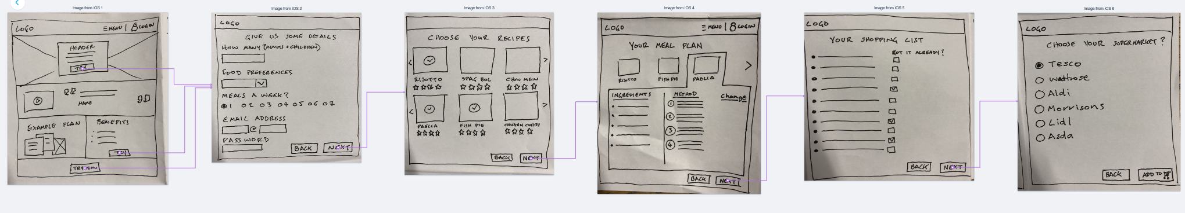
The Journey

Slide 12
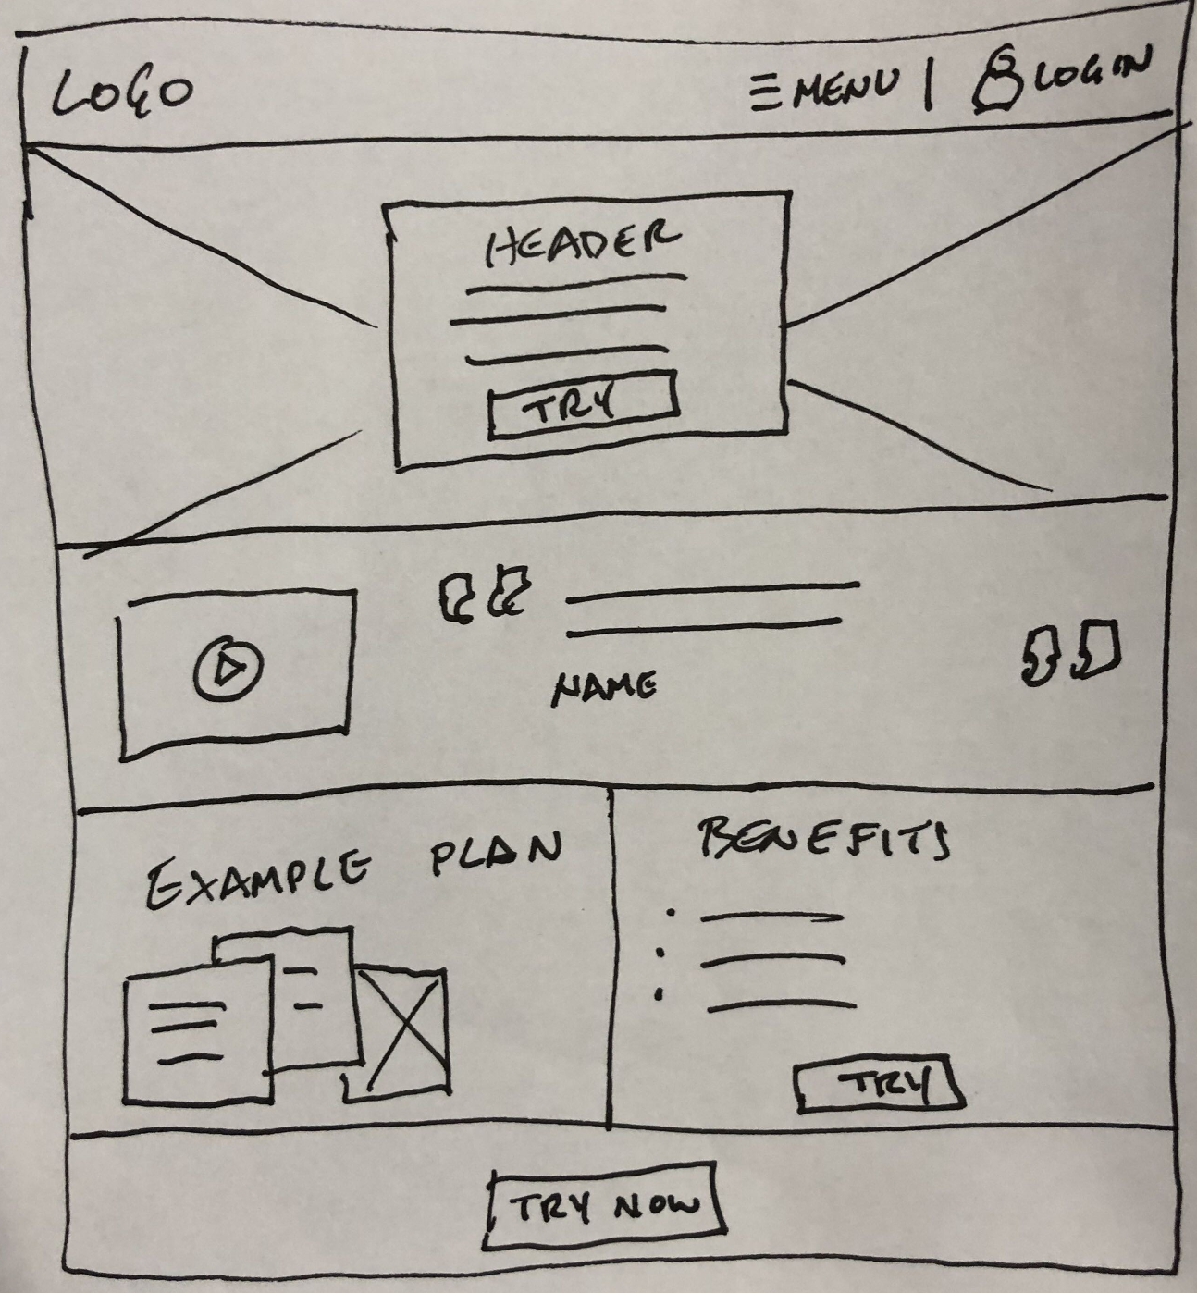
WIREFRAMES

Slide 15
Kanban or Roadmap

Slide 16
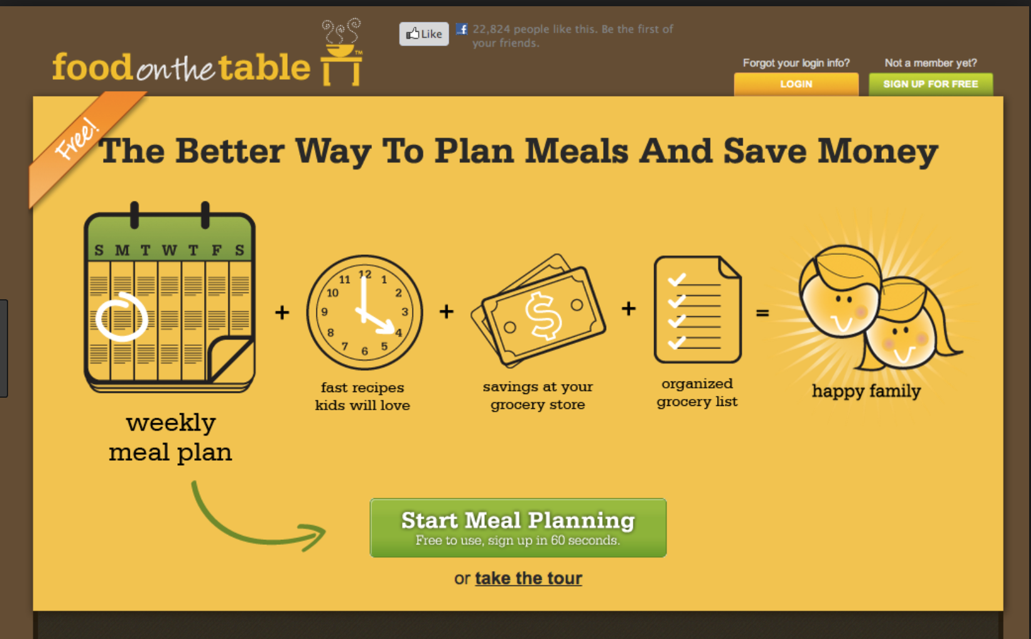
Conclusion
KEY MESSAGES!!!
Healthy food for all…

